Slide 1
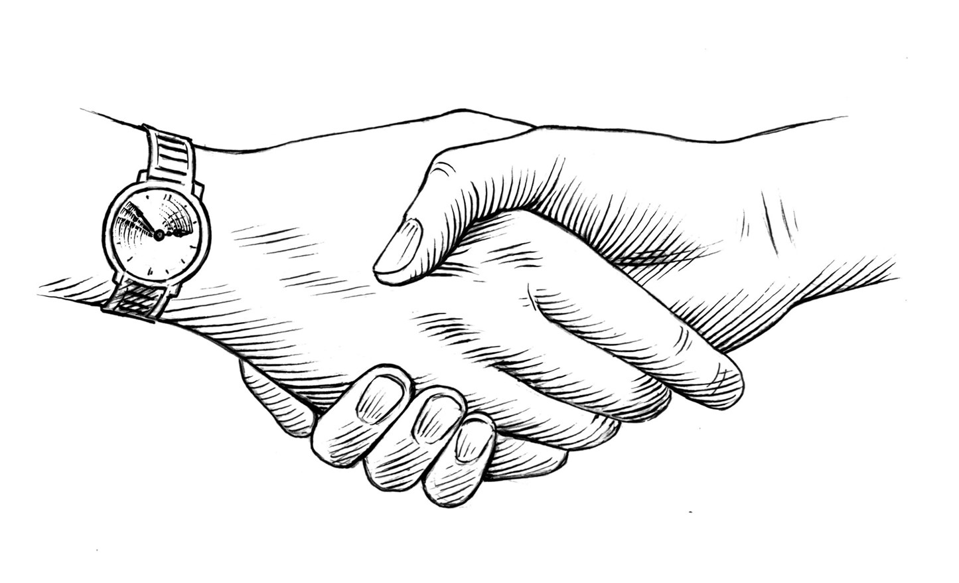
LMC Workshop NAVIGATING CHANGE through PARTNERSHIP
Notes:
Welcome everyone. Introduce all key players
Go through training agenda, highlighting important items (goal, objectives, key times)
Transition to ice-breaker activity

Slide 2
ICE-BREAKER ACTIVITY
Notes:
Ice-breaker activity:
1) Find someone you do not know
2) Learn their name, job title, work unit or area
3) Ask them to share with you EITHER one thing they are excited about OR one thing they have a question about with respect to the Labor Management Committees
4) Be prepared to introduce your partner to the rest of the group (take notes if necessary)
-After 5 min, ask pairs to introduce each other
-Wrap up: thank you all for participating in our ice-breaker activity. It’s really important that we recognize the value of having such a diverse group here today. That is one of the strengths of the LMC: it brings together a diverse group of individuals, from various areas of the facility, who all bring different viewpoints and experiences, and we work together toward a common goal. It’s an incredibly powerful idea, especially in this time of cultural change and transformation at LAC+USC.
-Transition: Let’s move along to our next activity. In a moment, we will be diving up into small groups.

Slide 3
THE TALLEST TOWER
GOAL: Build the tallest freestanding
tower you can with the supplies in the bags
Instructions:
1) Divide into assigned teams
2) Come up with a team name
3) Designate a team leader
4) Receive materials
5) You have 20 minutes to complete the activity
**Winners will receive prizes.**
Notes:
Introduce the exercise: “The Tallest Tower.” And tell the group that it is an exercise about communication and collaboration. Then randomly divide participants into groups of 4-5. It’s ideal to have at least 3-4 separate groups working on this project. Ask each group to elect a team captain and a team name. Write the names of the teams on a white board or chart paper.
Ask the team captains to come to the front and select a bag of supplies. Tell the groups that each one of them has a special power, which they will find in their bags. IN ORDER TO USE YOUR SPECIAL POWER, THE GROUP MUST FOLLOW THE INSTRUCTIONS ON THE RED CARDS. Then give these specific instructions: “The goal is to build the tallest free-standing tower with the supplies in the bags – and ONLY the supplies in the bags. Winners will receive prizes. You have 20 minutes. Go.”
Participants are given 20 minutes to build their towers
HALFTIME:
Stop building
Ask for representatives of each group to explain their building process, their challenges and their successes so far
[This gives the groups opportunity to notice the unequal distribution of supplies]
After the 20 minutes are up, measure the separate structures and reward the winning team with prizes. (Assuming they did not collaborate, which is the best outcome). Make sure you have enough prizes for all participants, but only give the reward to the winning team – for now. Circle the team’s name on the white board, shower them with praise.
Debrief. The instructor then leads a brief summary discussion. Some sample discussion questions:
Raise your hand if you helped build a tower!
What worked well?
What challenges did you encounter and how did you overcome them?
Did you build the tallest tower you could? Why or why not?
Add the following questions if the groups did not collaborate or share supplies:
Did you assume that you were only supposed to collaborate with those in your small group?
What would have been possible if you had decided to share resources with the whole group?
Would you have had a taller tower?
Why didn't you?
Did teams choose to use their special ability? Why or why not?
Did you assume that there were only prizes for ONE GROUP of winners? Well, you were wrong – there are enough prizes for everyone! (Distribute prizes to the rest of the group…) Sometimes we think that the rewards for our work are limited, but most often, there is enough to go around…
Add the following questions if the groups collaborate:
How did you come to the decision to collaborate?
What became possible once you made the decision to share resources?
What was challenging?
And then to make the issues really hit home, you need to tie it back to collaboration and communication on your specific team or group:
How does building the tower in this activity compare to your daily work? or the way our group is organized? (Point out that dividing into teams is like dividing a work cohort into units or departments – it’s necessary but might encourage competition)…
How does this activity relate to being part of the larger company, organization, or group?
What are the real world barriers to collaboration, and how can we draw parallels between this exercise and the real world?
How can we encourage collaboration, communication, and sharing among the whole group?
[SEE TALLEST TOWER LESSON PLAN FOR MORE DETAILS]

Slide 4
PARTNERSHIP
Improving Care
Collaboration
Opportunity
LMC
Accountability
Equal Voice for All
Respect
Give and Take
Unified Goals
Finding Solutions Together
Teamwork
Notes:
The title of this workshop is Navigating Change through Partnership.
During our first meeting, Partnership 101, the facilitators opened up the floor to ideas about what the idea of Partnership means. The idea of Partnership is a fundamental part of why we’re here today. The idea that the Union and Management are much stronger when they work together toward common goals.
So what were some of your responses to this idea of Partnership?
[READ ALOUD ALL DESCRIPTORS FROM P101]
These are all transformative ideas - a complete change in the way that we do business here at LAC+USC
This LMC is really the embodiment of this culture change.
In fact, if we took the word “Partnership” out of this slide and replaced it with LMC, it would do a pretty good job of defining what this group is.
Our group has the opportunity to represent this culture change in everything that we do moving forward.
It’s a very exciting opportunity, but it will not be without its challenges. We need to recognize that any transformation of this magnitude will not happen without a few bumps in the road. Here’s one way to think about the process of change..

Slide 5
Notes:
Change is a process. It’s not like flipping a light switch.
Big changes, transformative changes, like the one brought on by Obamacare, often take a lot of time and effort to fully take hold. Here’s one theory of change.
[Go through content of slide, explaining how the process relates to DHS transformation].
Does this reflect your experience?

Slide 6
EFFECTIVE COMMITTEES
Productive
Efficient
Responsive
Notes:
When our team was developing the curriculum for this workshop, we envisioned what a highly effective LMC would look like. And we let that vision guide us. And we identified three characteristics of a highly effective LMC:
When we envision a highly effective LMC, we see a group that’s productive. We see a group that’s able to identify issues or challenges that need to be addressed and respond with innovative projects or initiatives.
When we envision a highly effective LMC, we see a group that is efficient. We see a group that uses their time and resources wisely. We see a group that understands what its role is, and how to leverage its collective strength to create an impact.
When we envision a highly effective LMC, we see a group that is responsive. We see a group that has its finger on the pulse of what is happening in their workplace. We see a group that recognizes that our most valuable asset at DHS is our people.
So now that we’ve spent a little bit of time thinking about “what” our LMC is, we’re going to spend much of the rest of our time together talking about “how.”
How do we turn all of our talk into action?
How can we make some of our big ideas a reality?
How do we work collaboratively to make LAC+USC a better place for everyone?
How do we do the actual work of transformation?
REFER TO MISSION STATEMENT DOCUMENT IN THE RESOURCE BINDER (2-page document, under section two, “Our LMC”)
Ask why a mission statement would be important
Describe the process of coming up with a mission statement, using the tools provided

Slide 7
Future Agenda Items
#1 - Create an LMC Mission Statement by using the Mission Statement worksheet.
Mission Statement
Our mission is to promote and preserve an organizational culture where there is mutual respect & trust.
Notes:
Now we have our first agenda item for your committee to tackle in the first weeks following this training:
Create a mission statement (or charter)
Explain that groups can create a charter if they feel it is necessary (a charter is a much more detailed version of a foundational document, which would include the mission statement, and we have an example of a charter they could use as a model.)
[ASK FOR A VOLUNTEER to write this agenda item on the “Future Agenda Items” chart paper.]

Slide 8
Effective Meeting
What are the key roles and responsibilities of effective teams?
Notes:
What are the nuts and bolts of how an effective committee operates? Well, let’s first talk about the roles and responsibilities of team members in our LMC.
Every committee needs defined roles, and each of those roles comes with a set of responsibilities.
[REFER TO ROLES AND RESPONSIBILITIES DOCUMENT IN THE RESOURCE BINDER (under section two, “Our LMC”)]
Very IMPORTANT: Groups may not be used to having co-chairs collaborate on creating the agenda. Underline this. Then: Why is this important?
Transition: In order to have an effective committee, we need to define roles…

Slide 9
Future Agenda Items
#1 - Create an LMC Mission Statement by using the Mission Statement worksheet.
#2 - Assign committee roles.
Notes:
Now we have our second agenda item for your committee to tackle in the first weeks following this training:
2. Assign committee roles
Explain that groups can determine which roles best serve their committees. They can even add or subtract roles as necessary. All roles are held on a rotating basis, to be determined by each individual group.
[ASK FOR A VOLUNTEER to write this agenda item on the “Future Agenda Items” chart paper.]
Transition: Let’s return to our discussion of how we can create the most effective committee…

Slide 10
Effective Meeting
What are the key roles and responsibilities of effective teams?
How do we use our meetings to be productive, efficient, and responsive?
Notes:
One of the most important tools for the committee is the monthly meeting. Why is this meeting so important? What value does it bring to the committee? Let’s talk about how our monthly meetings should unfold in order to ensure the best possible outcomes.
First, ground rules. What is the purpose of ground rules? What kind of ground rules do we want to institute for this group moving forward?
[GUIDE DISCUSSION OF WHAT GROUND RULES SHOULD GOVERN THE GROUP, USING GROUND RULES HANDOUT]
[List Ground Rules on CHART PAPER that can hang in the room for the rest of the workshop.]
Sample GROUND RULES:
1. Make sure everyone is able to contribute: more talkative people - show a little restraint; quieter people - your contributions are very welcome.
2. Only one person speaks at a time: put up your hand if you want to speak and wait for your turn.
3. Respect each other’s opinions even and especially if you don’t agree with them.
4. Participate!
5. Confidentiality – some things shouldn’t be repeated outside of this meeting.
6. Be conscious of time – help stick to it, or negotiate for more.
7. Mobile phones off to minimize disruptions.
8. Regular breaks
Transition: We would also recommend creating a roster of every member of your committee, along with their role, if applicable
[INTRODUCE THE LMC TEAM MEMBER CONTACT LIST document. (section one, “OUR LMC”]
BRIEFLY DISCUSS WHY THIS IS NECESSARY.
List of LMC members available for all. Why?
Who should keep the list? Where should it be put? (on the website)].
___
Transition: Now let’s talk about the components of a meeting - the preparation, the meeting itself, and the follow-up. For this, we suggest that the LMC co-chairs complete the LMC MEETING CHECKLIST for every meeting.
[INTRODUCE THE LMC MEETING CHECKLIST document. (section two, “OUR MEETINGS”]
Discuss using the checklist to prepare for meetings each month
This checklist should be used by co-Chairs to make sure they are covering all of their bases
[INTRODUCE THE LMC AGENDA TEMPLATE document. (section two, “OUR MEETINGS”]
All meetings should have an agenda that both labor and management have helped create
The agenda should be distributed to all committee members a least seven days before the meeting. Why?
[INTRODUCE THE LMC MINUTES TEMPLATE document. (section two, “OUR MEETINGS”]
This document (or something like it) is used by the recorder to document the official minutes of every LMC meeting
The minutes should be sent out to all members no later that one week after the meeting occurred. Why?
[INTRODUCE THE CHARTING handout. (section two, “OUR MEETINGS”]
Charting (like we are doing during this training today) assures that everyone is on the same page with the most important aspects of the committee’s work
Charting might seem like a lot of work. Is it worth it? Why?
Transition: We encourage you to use the tools we have just talked about or adapt them to a format that suits your group’s needs. We will be sending digital versions all of these documents to the co-leads of each LMC so they can be used or adapted. Now let’s talk about something just as important as effective meetings, and that is effective communication.

Slide 11
External Communications
In between meetings, how can we communicate with our constituents about our progress and ask for their input?
Notes:
We’ve talked about how the LMC can be a voice for staff, how we need to be inclusive, how as leaders we need to represent our colleagues, whether they are union members or management.
This is a powerful group, and with power comes responsibility.
This group has a responsibility to answer to its constituents. LMC= LABOR + MANAGEMENT. So that’s who we represent, LABOR and MANAGEMENT.
So how do we ensure that we are communicating effectively with our constituents?
Communication is a two-way street.
First, we need to get the word out about what we’re up to.
But also, and this is almost more important, as leaders we need to always be listening.
Through research, we’ve uncovered a few ideas about how to engage in this crucial external communications piece. Here are a few of those ideas…

Slide 12
External Communications
Getting the Word Out | Asking for Input
One on one blitz
Fact sheet
Departmental / Unit meetings
Communication subcommittee?
Union meetings
Admin. meetings
Roundtable or Team sharing forum
Graffiti board
Expanded group meetings
Open meetings
Questionnaires / surveys
Notes:
[INTRODUCE EXTERNAL COMMUNICATIONS DOCUMENT (section two, Our LMC)]
Here are some ideas about how to engage your constituents. Do you have any other ideas?
Transition: We want to make external communications a priority for your LMCs, we we’re going to add it to the agenda for the group to consider.

Slide 13
Future Agenda Items
#1 - Create an LMC Mission Statement by using the Mission Statement worksheet.
#2 - Assign committee roles.
#3 - How will our LMC communicate with our constituents, get their input, and let them know about the great work we're doing on their behalf?
Notes:
Now we have our third agenda item for your committee to tackle in the first weeks following this training:
3. Decide how the LMC will communicate with constituents.
Explain that groups can designate a sub-committee on communications if they wish.
[ASK FOR A VOLUNTEER to write this agenda item on the “Future Agenda Items” chart paper.]

Slide 14
Project-Focused Committee
How can our group work together proactively to make LAC+USC a better place?
LMC Project Management Tools:
Brainstorming tools
Setting Criteria
The LMC Subcommittee
The Work Plan
Notes:
We’ve talked about how the focus of the LMC is shifting from reactive to proactive. The idea here is that the committee has a unique perspective and ability to create positive change throughout the facility.
Completing projects in a collaborative way is what partnership is all about.
It demonstrates we are stronger when we work together
It demonstrates that everyone has something at stake and everyone has valuable input with respect to improving our facility
Project management concepts:
Brainstorming tools
Think. Create. Share. [reference this innovative project exercise, section four “Our Projects”]
Brainstorming exercises [reference this brainstorming exercise, section four “Our Projects”]
Setting Criteria
How does a group decide on the project?
Setting criteria helps the group focus their discussion on what really matters
A-B-C criteria is a simple way to determine which ideas are best [reference this one-sheet, section four “Our Projects”]
The subcommittee [reference The LMC Subcommittee document, section four “Our Projects”]
Why would we want to use subcommittees to help manage projects?
The project work plan [reference the Work Plan Template, section four “Our Projects”]

Slide 15
Future Agenda Items
#1 - Create an LMC Mission Statement by using the Mission Statement worksheet.
#2 - Assign committee roles.
#3 - How will our LMC communicate with our constituents, get their input, and let them know about the great work we're doing on their behalf?
#4 - Complete first collaborative project.
Notes:
Now we have our final agenda item for your committee to tackle in the first weeks following this training:
4. Complete first collaborative project
This might be a little bit of a change from what the group has focused on in the past
We recommend starting small: picking something that will give the group a relatively quick “win” to start
There isn’t a strict timeline, but consider finishing your first project in the first 3-6 months
[ASK FOR A VOLUNTEER to write this agenda item on the “Future Agenda Items” chart paper.]
Transition: So far we’ve talked about a lot of ways to make our committee more productive efficient and responsive. And we’re hoping that your committee will take these skills and apply them to the work ahead. We don’t expect everyone to be experts with these tools right away. But we know that with some practice, this group can be very successful…

Slide 16
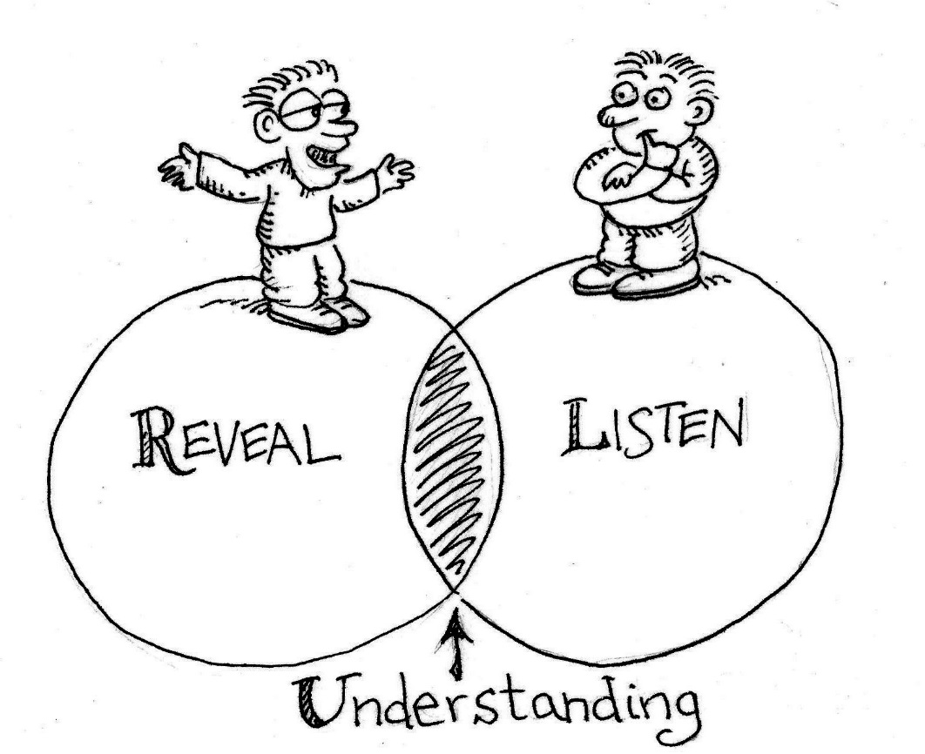
PROBLEM SOLVING
How does our committee work to resolve problems that are brought before it?
Notes:
Still, even highly effective committees encounter barriers to their progress, problems that they must solve. And we’d like to suggest an approach toward dealing with these issues that will inevitably arise. Let’s talk about committee problem solving.

Slide 17
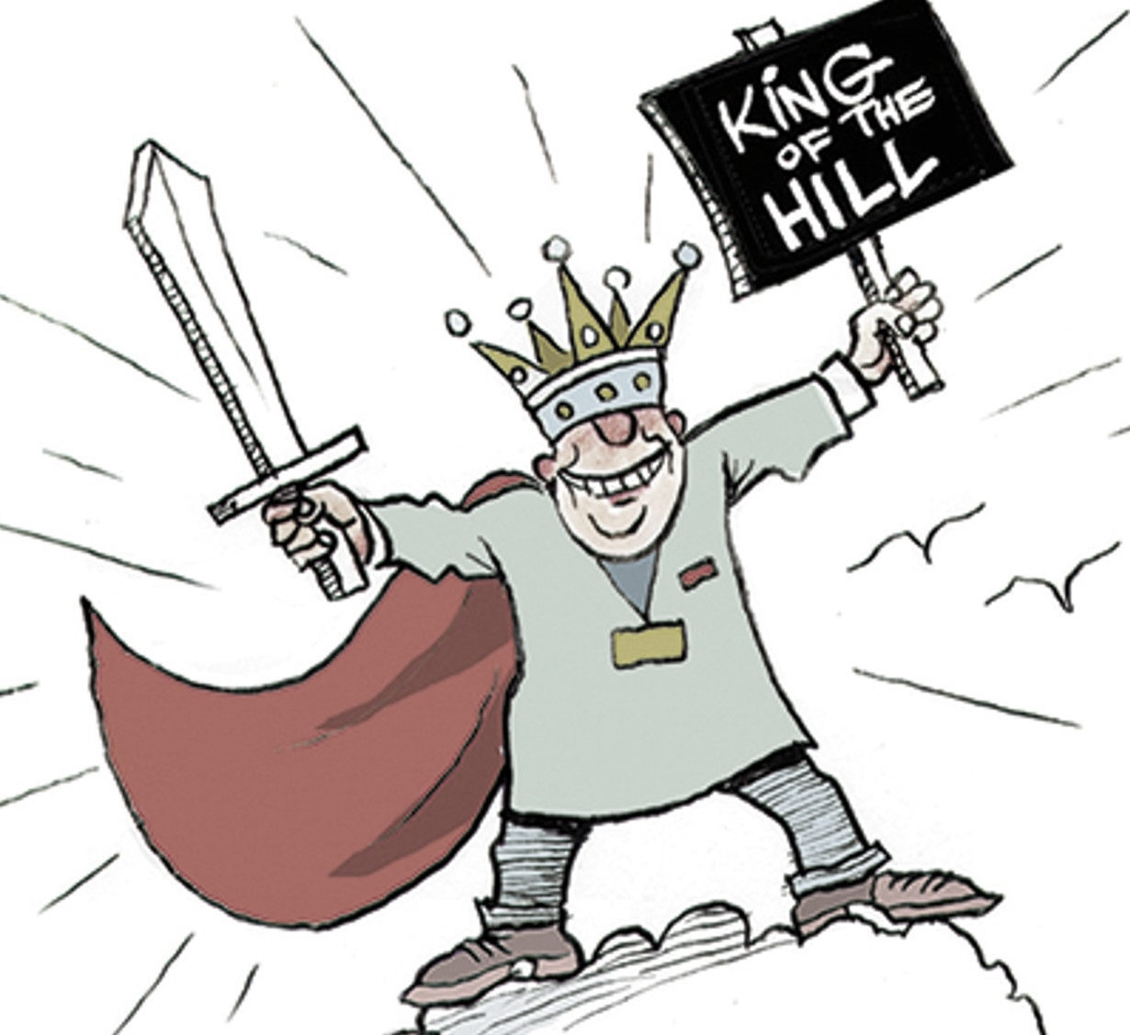
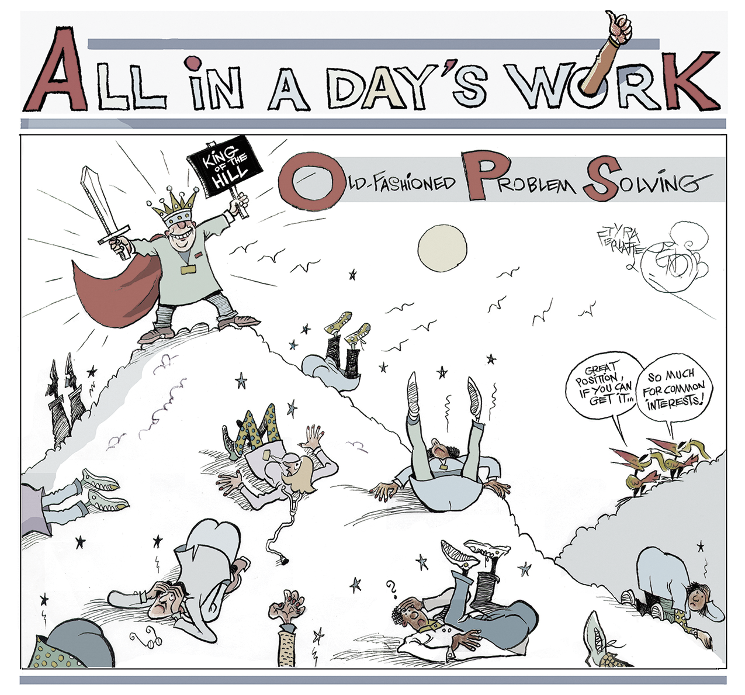
Do you have experience working in this kind of problem-solving environment?
Notes:
Do any of you have experience working in this kind of problem-solving environment?
Yes? Well, we all laugh about this, but it does represent one way to solve problems. Some might describe it as a dictatorial approach.
And what are the benefits of the dictatorial approach to problem solving?
What are the drawbacks?
Of course, we don’t advocate for the dictatorial approach. That said, how do we solve problems effectively? We’d like to suggest a different approach.

Slide 18
PROBLEM SOLVING
Traditional Problem Solving
Interest Based Problem Solving
Parties come to the table with strong opinions about the solution to the problem.
Parties come to the table with open minds. They want their interests to be considered, but they also want to listen to others' concerns.
Each party's goal is to "win" the argument by imposing their solution on the group.
Parties see each other as willing to work together to solve the problem through open communication, information sharing, innovation and creativity.
After lots of conflict, those in power or authority usually get their way or force a compromise on the group.
After lots of discussion, the group uses a consensus-based approach to reach a decision, where everyone has an equal voice.
Notes:
First, let’s explore a traditional approach to problem solving, which is often antagonistic in nature.
Traditional approach to problem solving:
Parties come to the table with strong opinions about the solution to the problem.
Each party's goal is to "win" the argument by imposing their solution on the group.
After lots of conflict, those in power or authority usually get their way or force a compromise on the group.
Interest-Based Problem Solving:
Parties come to the table with open minds. They want their interests to be considered, but they also want to listen to others' concerns.
Parties see each other as willing to work together to solve the problem through open communication, information sharing, innovation and creativity.
After lots of discussion, the group uses a consensus-based approach to reach a decision, where everyone has an equal voice.
Highlight that while there are certainly skills associated with this approach, the most important thing is how the parties APPROACH problem solving. On one hand, they’re looking for a fight. On the other hand, their looking for common ground. That’s the key.
Megaphone Created by Rocketpixel - Freepik.com

Slide 19
Notes:
Let’s have a look at how the IBPS approach plays out in a four-step process.
[Reference “How IBPS Works,” section five, “OUR TOOLS”]

Slide 20
1
DEFINE THE ISSUE
Task : Describe the problem that needs to be addressed.
Why: Expressing the problem by itself removed the opinions on how it should be solved.
Notes:
1) Define this issue:
Start here, in order to make sure everyone is on the same page.
If you don’t have agreement about what the problem is, there’s no path toward solving it
KEY: Refrain from solutions or approaches to the problem here. Instead, reach an agreement about the key issues, with both sides laying out their own perspectives.

Slide 21
2
DETERMINE INTERESTS
Task: each side develops its own list of interests by describing why the problem is important and stating the underlying concern. Once the separate lists are complete, the two sides sit together and build a list of their interests.
Why: This approach allows both sides to focus on core concerns, which are often similar, and avoid taking extreme positions.
Notes:
2) Determine Interests:
This is the most fundamental part of the process, and is often what groups skip over
By determining each parties’ interest, the committee recognizes differences, but also, more importantly, they find areas that they have IN COMMON: Common interests
KEY: Again, the temptation is to jump right into solutions. THAT’S NOT AN INTEREST, THAT’S A POSITION. Stay away from positions at this point in the process!!!

Slide 22
IS THAT ‘INTEREST’ REALLY A POSITION?
A position tells us what you want but not necessarily why you want it.
An interest tells us what is important to you.
What do you do when you’ve got a position masquerading as an interest? Usually, you can get to the interests that underlie a position if you listen carefully and ask the right questions. Find out the needs and concerns behind the position by asking “WHY?”
A spouse wants to put 5 percent of income into a retirement fund.
A spouse wants enough saved to have a comfortable retirement.
A parent wants a child in bed by 9:30 on a weeknight.
A parent wants a child to be well rested for school the next day.
A union wants a 3 percent across-the-board wage increase in collective bargaining.
A union rep wants a compensation package for members that aids recruitment and retention.
Notes:
[Go through the examples at the bottom of the page – Interests vs. Positions]

Slide 23
3
DEVELOP OPTIONS
TASK: Brainstorm potential solutions.
WHY: Brainstorming allows for a wide range of possible solutions to emerge. The best ideas may come out of the synergy of the process.
Notes:
3) Develop Options
Brainstorm potential solutions to the defined issue (don’t censor any potential solutions – it will be tempting!!!)
Yes, we’re finally ready to move on to potential solutions!
KEY: The brainstormed ideas should address the SHARED INTERESTS that all sides have identified

Slide 24
4
SELECT SOLUTIONS
TASK: Reach consensus on a solution or solutions.
WHY: Reaching consensus allows everyone involved in the process to support the final product. Each person weighs in with a thumbs up or a thumbs down. Some issues need more discussion and more rounds of polling before all parties can live with the result.
Notes:
4) Select solutions
Reach CONSENSUS on a solution or solutions
KEY: It’s important that all members of the committee are aligned with the solution. If the solution is only agreed on by 51% of the committee, do you think it will work when implemented? Why not?
[We are going to talk more about consensus decision making in a little bit…]
Transition: But right now, we’d like to practice the IBPS process with a role play activity…

Slide 25
Interest-Based Problem Solving The Case of the 3rd Floor Break Room
Earlier this week, a note was posted on the door of the 3rd Floor Break room at Harbor View Hospital. It read:
ATTENTION ALL STAFF!! THE 3RD FLOOR BREAK ROOM IS ONLY FOR PHYSICIANS. IF YOU ARE NOT A PHYSICIAN, YOU NEED TO USE THE 1ST FLOOR BREAK ROOM NEAR THE CAFETERIA. DO NOT PUT YOUR ITEMS IN THE FRIDGE, AND DO NOT USE THE VENDING MACHINES IN THIS BREAK ROOM!!!!
THANK YOU, MANAGEMENT :)
Notes:
[Ask participant to read the scenario aloud].

Slide 26
Interest-Based Problem Solving The Case of the 3rd Floor Break Room
Role Play: During their co-chair pre-meeting, Mr./Ms. Williams (Nurse Manager) and Mr./Ms. Garcia (RN) address the note. Mr./Ms.
Garcia heard that Mr./Ms. Williams approved the note. Everyone on the 3rd and 4th floors is very upset about it.
How will they solve the problem?
Earlier this week, a note was posted on the door of the 3rd Floor Break room at Harbor View Hospital. It read:
ATTENTION ALL STAFF!! THE 3RD FLOOR BREAK ROOM IS ONLY FOR PHYSICIANS. IF YOU ARE NOT A PHYSICIAN, YOU NEED TO USE THE 1ST FLOOR BREAK ROOM NEAR THE CAFETERIA. DO NOT PUT YOUR ITEMS IN THE FRIDGE, AND DO NOT USE THE VENDING MACHINES IN THIS BREAK ROOM!!!!
THANK YOU, MANAGEMENT :)
Notes:
Role Play: During their co-chair pre-meeting, Mr./Ms. Williams (Assistant Hospital Administrator) and Mr./Ms. Garcia (Social Worker) address the note. Mr./Ms. Garcia heard that Mr./Ms. Williams approved the note. Everyone on the 3rd and 4th floors is very upset about it.
How will they solve the problem?
Ask two separate pairs of role players (one union, one management in each pair) to come into the hallway.
One pair takes on the contentious Role Play, the other group takes the IBPS role play.
Bring in the contentious role play first.
Feedback from participants
Bring in the IBPS role play second
Feedback from participants

Slide 27
PROBLEM SOLVING
Traditional Problem Solving
Interest Based Problem Solving
Parties come to the table with open minds. They want their interests to be considered, but they also want to listen to others' concerns.
Parties see each other as willing to work together to solve the problem through open communication, information sharing, innovation and creativity.
After lots of discussion, the group uses a consensus-based approach to reach a decision, where everyone has an equal voice.
Parties come to the table with strong opinions about the solution to the problem.
Each party's goal is to "win" the argument by imposing their solution on the group.
After lots of conflict, those in power or authority usually get their way or force a compromise on the group.
Notes:
Review how the different role plays revealed the different approaches to problem-solving.
Ask participants to tell you how the role plays illustrated each specific point (be very specific about what was said/done during role plays)
Megaphone Created by Rocketpixel - Freepik.com

Slide 28
IBPS: The Case of the 3rd Floor Breakroom
1) Define the Issue
Immediate issue: Both sides agree that the 3rd floor breakroom is overcrowded. There’s not enough room for people to sit, and the refrigerator is always overflowing. (smaller issue, needs to be addressed now)
Underlying issue: Communicating and collaborating when a policy changes (larger issue, needs to be addressed as well, but might take a little longer to fully implement strategy)
Notes:
Define the issue. What is the issue?
Immediate issue: both sides agree that the 3rd floor breakroom is overcrowded. There’s not enough room for people to sit, and the refrigerator is always overflowing. (smaller issue, needs to be addressed now)
Underlying issue: Communicating and collaborating when a policy changes (larger issue, needs to be addressed as well, but might take a little longer to fully implement strategy)
**Even though (b) is an issue, let’s work on (a) right now and address (b) during a future meeting.

Slide 29
IBPS: The Case of the 3rd Floor Breakroom
2) Determine Interests
Staff want a conveniently located break room with vending machines and enough room for people to sit down.
(Why?) They want to be able to enjoy their breaks and return to work refreshed, not more stressed out.
Management wants to make the 3rd floor breakroom less crowded.
(Why?) They also want staff to enjoy their breaks so they can return to work refreshed, not more stressed out.
Notes:
Determine interests. What are the underlying needs and concerns of both sides?
Staff want a conveniently located break room with vending machines and enough room for people to sit down.
(BUT Why?) They want to be able to enjoy their breaks and return to work refreshed, not more stressed out.
Williams wants to avoid overcrowding in the breakrooms. (Why?) She also wants workers to enjoy their breaks so they can return to work refreshed, not more stressed out.
Develop solutions. What solutions might that addresses our shared interests?
Williams and Garcia each present a lot of different solutions.
They follow the brainstorming rules, and don’t censor anything.
Select solutions using consensus. Which of these solutions works best for both parties?
Williams might suggest that having workers use the 1st floor break room is the best way to go. It’s far bigger, so there’s room for everyone to sit. Also, there are three refrigerators – plenty of space.
Garcia has concerns about this solution. It takes time for workers on the third floor to go all the way to the first floor. Also, the first floor break room doesn’t have vending machines. Many of her colleagues use the vending machines on the 3rd floor every day.
Williams might suggest that she can have vending machines put in the first floor.
Garcia says that might work, but she still has concerns about people using 5 minutes of their 15 minute break to walk back and forth. The elevators are really slow.
Williams suggests that the breaks be extended by 5 minutes to let people on the 3rd and 4th floors reach the 1st floor break room.
Garcia says that might work, and that they could present this proposal at the next LMC meeting.
They both agree to present the proposal at the next LMC, as well as create an agenda item regarding communication around policy changes (the larger issue at hand here).
[Reference the “Overview of Interest-Based Problem Solving” document, “OUR RESOURCES, section 5. Don’t read through it, as it is just a review of what was discussed].

Slide 30
IBPS: The Case of the 3rd Floor Breakroom
3) Develop Solutions
-Staff and management each present a lot of different solutions
-Both sides are encouraged to present solutions that address shared interests
-Both follow brainstorming rules, where there is no censoring
Notes:
Develop solutions. What solutions might that addresses our shared interests?
-Staff and management each present a lot of different solutions
-Both sides are encouraged to present solutions that address shared interests
-They follow brainstorming rules, where there is no censoring
Select solutions using consensus. Which of these solutions works best for both parties?
Williams might suggest that having workers use the 1st floor break room is the best way to go. It’s far bigger, so there’s room for everyone to sit. Also, there are three refrigerators – plenty of space.
Garcia has concerns about this solution. It takes time for workers on the third floor to go all the way to the first floor. Also, the first floor break room doesn’t have vending machines. Many of her colleagues use the vending machines on the 3rd floor every day.
Williams might suggest that she can have vending machines put in the first floor.
Garcia says that might work, but she still has concerns about people using 5 minutes of their 15 minute break to walk back and forth. The elevators are really slow.
Williams suggests that the breaks be extended by 5 minutes to let people on the 3rd and 4th floors reach the 1st floor break room.
Garcia says that might work, and that they could present this proposal at the next LMC meeting.
They both agree to present the proposal at the next LMC, as well as create an agenda item regarding communication around policy changes (the larger issue at hand here).
[Reference the “Overview of Interest-Based Problem Solving” document, “OUR RESOURCES, section 5. Don’t read through it, as it is just a review of what was discussed].

Slide 31
IBPS: The Case of the 3rd Floor Breakroom
4) Select Solutions
-Management: The 1st floor break room is the best solution
-Staff: It takes time for workers on the third floor to go all the way to the first floor. Also, the first floor break room doesn’t have vending machines.
-Management: We can have vending machines put in the first floor.
-Staff: We still have concerns about people using 5 minutes of their 15 minute break to walk back and forth. The elevators are really slow.
-Management: Breaks can be extended by 5 minutes to let people on the 3rd and 4th floors reach the 1st floor break room.
-Both: Agree to present the proposal at the next LMC, as well as create an agenda item regarding communication around policy changes (the larger issue at hand here).
Notes:
Select solutions using consensus. Which of these solutions works best for both parties?
-Management might suggest that having workers use the 1st floor break room is the best way to go. It’s far bigger, so there’s room for everyone to sit. Also, there are three refrigerators – plenty of space.
-Staff have concerns about this solution. It takes time for workers on the third floor to go all the way to the first floor. Also, the first floor break room doesn’t have vending machines. Many staff use the vending machines on the 3rd floor every day.
-Management might suggest that they can have vending machines put in the first floor.
-Staff says that might work, but they still have concerns about people using 5 minutes of their 15 minute break to walk back and forth. The elevators are really slow.
-Management suggests that the breaks be extended by 5 minutes to let people on the 3rd and 4th floors reach the 1st floor break room.
-Staff thinks that might work, and that they could present this proposal at the next LMC meeting.
-Both agree to present the proposal at the next LMC, as well as create an agenda item regarding communication around policy changes (the larger issue at hand here).
[Reference the “Overview of Interest-Based Problem Solving” document, “OUR RESOURCES, section 5. Don’t read through it, as it is just a review of what was discussed].

Slide 32
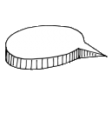
Group Decision Making
How do we ensure that everyone in our group has input on all key decisions?
Notes:
Our final topic today is consensus decision making. Anyone familiar with this kind of decision making? What do you understand about it?
[Read through “Consensus Decision Making” introduction, section five, “OUR RESOURCES”]

Slide 33
Group Decision Making Techniques
How do we ensure that everyone in our group has input on all key decisions?
Majority Vote | Consensus
+
Quick
Everyone knows method
Easy for large groups
+
A win/win approach
Requires input from all
Promotes buy-in from all
-
More difficult to get buy-in
Promotes winners and losers
May not encourage everyone to participate
-
Takes time to accomplish
Demands openness and honesty
A new skill that needs to be developed
Notes:
Consensus isn’t the only way that committees make decisions. Another way, which we are all familiar with, is majority vote. It’s how our democracy is run.
What are the features of majority vote decision making?
What are the drawbacks?
Have you used majority vote in committees before? Did it work?
We would like to suggest that our LMC uses the consensus approach. Consensus is an important part of HOW we operate, as it reflects our shared values of equal voice for all and a fully-empowered union and management.
How do we build consensus? Well, let’s take a look at one way to get there - the 5-step consensus building process.
[Reference “How to Reach Consensus” tool, section five, “OUR RESOURCES”]
Transition: It’s important to note that in a consensus decision-making environment, any SINGLE COMMITTEE MEMBER can effectively block the group from moving forward. We call this a “Stand Out.” A standout is any group member who does not agree to move forward on a given proposal.

Slide 34
What About Stand Outs?
STANDOUTS: One or more team members who are not willing to support the proposal in its current form.
Responsibilities of the Standout | Responsibilities of the Group
Stay involved with the group Clearly explain perspective - blocks to consensus must be paramount and reasoned Offer solutions that will remove the block | Support the Standout and his/her right to express concerns Consider the solution offered by Standout If necessary, offer your own suggestions to remove the block
Escape Hatch: Consensus-1 or SUPER Majority
Notes:
KEY MESSAGE: The Standout’s voice is important, and Standing Out should not be considered a bad thing. It takes great courage to be one of the only Standouts in a group that is otherwise in agreement. But it takes an equal amount of courage (and sometimes even more) to set aside differences in order to help the group move forward toward its goal.
Transition: So now, let’s practice consensus decision-making with a case study scenario, back at Harbor View Hospital.

Slide 35
Reaching Consensus – Let’s Practice
As the Harbor View LMC, you have decided to develop a project that will improve the patient experience at your facility. You have already decided on the following criteria for the project:
Achievable - Since this is Harbor View LMC’s first project, the project shouldn’t be overly complex.
Believable - Strong leadership exists to move it forward.
Cost effective - Not requiring too much time or money while impacting as many patients as possible (completed in 90 days).
5
The committee has also brainstormed and narrowed down their brainstorm to five remaining ideas. Now it must reach a consensus around one of the ideas.
Notes:
The ROLE PLAY now requires that the group use consensus building methods and structured discussion to reach a consensus about how to move forward.
1) Lead the group through a multiple voting exercise, try to prioritize which of the proposals has the most support.
2) Lead the group through structured discussion, allowing everyone to express his/her opinions. Everyone has 1 minute.
3) Ask the group for new proposals that might remove blocks that people have or combine proposals to make one that everyone can support.
If the group cannot for whatever reason reach a consensus after sufficient time, or if the group becomes fractious or blocked, the facilitator should ask a volunteer to read the following to the group:
“I would like to respectfully remind our group of the commitment that we have made to partnership and culture change here at Harbor View Hospital. As leaders, we have a responsibility to our staff, our management, and most importantly, our patients to reach a consensus decision about this matter together. While sticking to your convictions is a courageous thing to do, it’s sometimes even more courageous to decide to make a compromise so that the group can move forward. I encourage every one of us to reconsider our positions on this decision. Let’s use this opportunity to show that our group can overcome these difficult obstacles and truly move forward in a collaborative way.”
[Debrief: What are the challenges of reaching consensus? Can you envision this group using the techniques? Why or why not?]

Slide 36
LMC Workshop NAVIGATING CHANGE through PARTNERSHIP
Notes:
Welcome everyone. Introduce all key players
Go through training agenda, highlighting important items (goal, objectives, key times)
Transition to ice-breaker activity

